Slide 1
FINAL TERM
Physics 1 [Spring 2020-2021]
Department of Physics
Faculty of Science & Technology (FST)
American International University-Bangladesh

Slide 2
Reference Books
Fundamentals of Physics (Edition: 10th) Written by Halliday, Resnick and Walker
University Physics (13/14th Edition) written by Hugh D. Young and Roger A. Freedman

Slide 3
LESSON 1
BOOK CHAPTER 22
ELECTRIC FIELDS

Slide 4
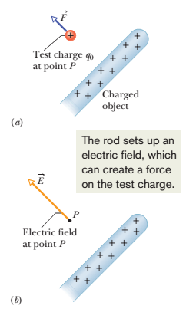
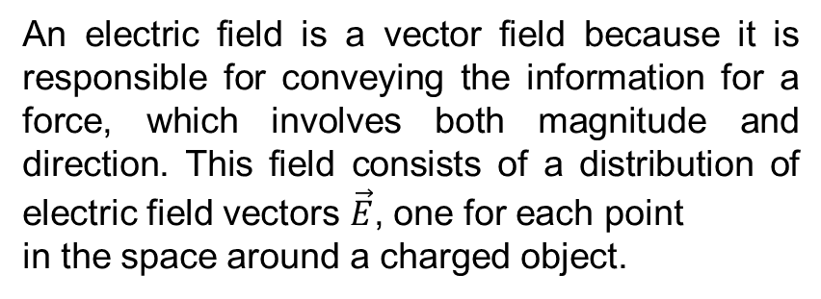
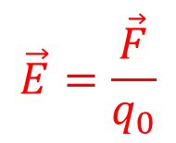
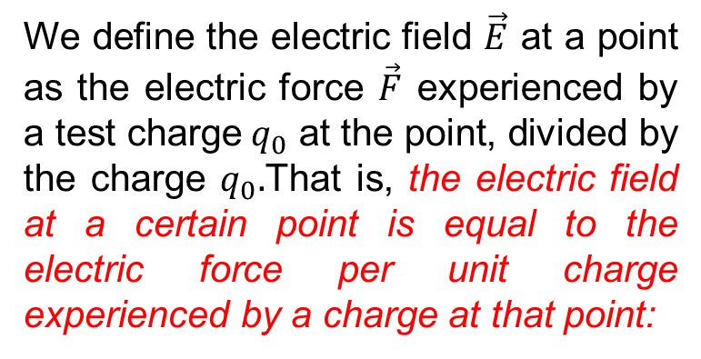
Electric Fields
An electric field is a vector field because it is responsible for conveying the information for a force, which involves both magnitude and direction. This field consists of a distribution of electric field vectors $\vec{E}$, one for each point
in the space around a charged object.
We define the electric field $\vec{E}$ at a point as the electric force $\vec{F}$ experienced by a test charge${ q}_{0}$ at the point, divided by the charge $q_{0}.$That is, the electric field at a certain point is equal to the electric force per unit charge experienced by a charge at that point:
$$\vec{E}=\frac{\vec{F}}{q_{0}}$$
The SI unit for the electric field is the
Newton per Coulomb (N/C).

Slide 5
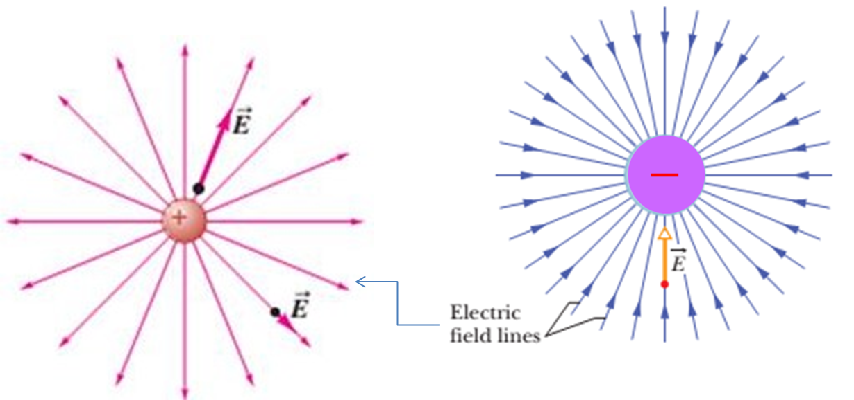
Electric Field lines around charged particles (Point Charges):
The field produced by a positive point
charge points away from the charge
The field produced by a negative point
charge points toward the charge
Note: Electric field lines extend away from positive charge (where they originate) and toward negative charge (where they terminate).

Slide 6
Field lines for a positive point charge and a nearby negative point charge that are equal in magnitude.
Field lines for two equal positive
point charges.
Note: Electric field lines help us visualize the direction and magnitude of electric fields. The electric field vector at any point is tangent to the field line through that point. The density of field lines in that region is proportional to the magnitude of the electric field there. Thus, closer field lines represent a stronger field.

Slide 7

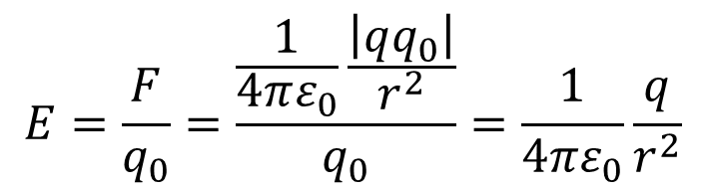










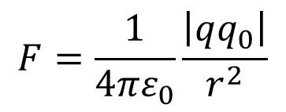






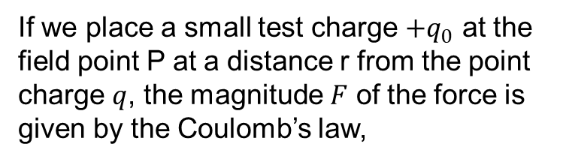


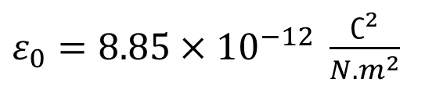


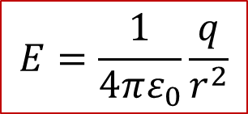

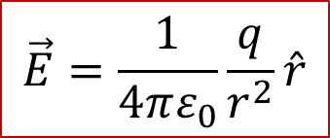

Electric Field due to a Point Charge:
If we place a small test charge ${+q}_{0}$ at the
field point P at a distance r from the point
charge $q$, the magnitude $F$ of the force is
given by the Coulomb’s law,
$${+q}_{0}$$
$$+q$$
$$r$$
$$\vec{E}$$
$$P$$
$$F=\frac{1}{4πε_{0}}\frac{\left|qq_{0}\right|}{r^{2}}$$
$${+q}_{0}$$
$$−q$$
$$r$$
$$\vec{E}$$
$$P$$
The quantity $ε_{0}$, called the permittivity constant. The value of $ε_{0}$ is
$ε_{0}=8.85×{10}^{−12} \frac{∁^{2}}{N.m^{2}}$
$$\hat{r}$$
$${+q}_{0}$$
$$+q$$
$$r$$
$$\vec{E}$$
$$P$$
The magnitude $E$ of the electric field at point P is
$$E=\frac{F}{q_{0}}=\frac{\frac{1}{4πε_{0}}\frac{\left|qq_{0}\right|}{r^{2}}}{q_{0}}=\frac{1}{4πε_{0}}\frac{q}{r^{2}}$$
$$\hat{r}$$
$${+q}_{0}$$
$$−q$$
$$r$$
$$\vec{E}$$
$$P$$
In vector form,
$$\vec{E}=\frac{1}{4πε_{0}}\frac{q}{r^{2}}\hat{r}$$
$$E=\frac{1}{4πε_{0}}\frac{q}{r^{2}}$$

Slide 8
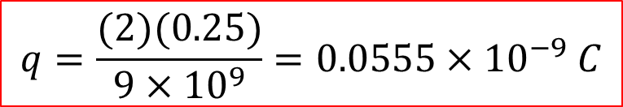

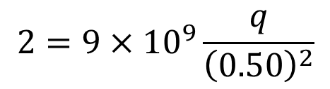
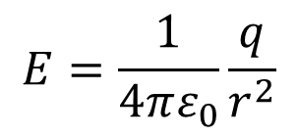
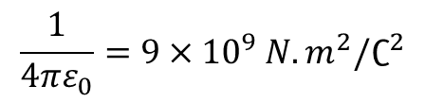


Problem 5 (Book chapter 22)
A charged particle produces an electric field with a magnitude of 2.0 N/C at a point that is 50 cm away from the particle. What is the magnitude of the particle’s charge?
Answer:
$$E=\frac{1}{4πε_{0}}\frac{q}{r^{2}}$$
Given
Required formula:
$$E=2.0 N/C$$
$$2=9×{10}^{9}\frac{q}{{\left(0.50\right)}^{2}}$$
$$r=50 cm=0.50 m$$
$$\frac{1}{4πε_{0}}=9×{10}^{9} N.m^{2}/∁^{2}$$
$$q=\frac{(2)(0.25)}{9×{10}^{9}}=0.0555×{10}^{−9} C$$
$$q=?$$
Problem 6 (Book chapter 22)
What is the magnitude of a point charge that would create an electric field of 1.00 N/C at points 1.00 m away?
Answer: Follow exactly similar steps to the answer of problem 5.

Slide 9



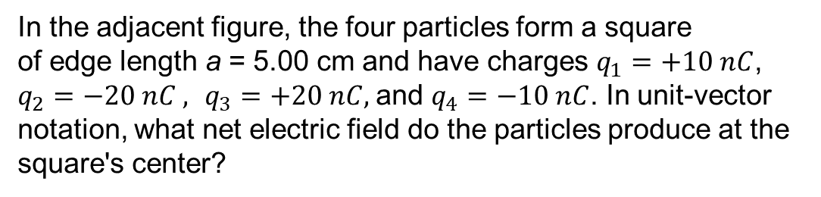









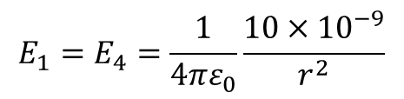




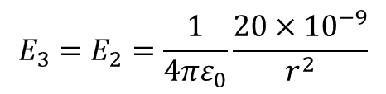
Problem 7 (Book chapter 22)
In the adjacent figure, the four particles form a square
of edge length a = 5.00 cm and have charges $q_{1}=+10 nC$, $q_{2}=−20 nC ,$ $q_{3}=+20 nC,$and $q_{4}=−10 nC$. In unit-vector notation, what net electric field do the particles produce at the square's center?
Answer:
The net electric field at the center of the square along
x-axis is
$$y$$
$$q_{1}=+10 nC$$
$$q_{2}=−20 nC$$
$$E_{x}=E_{2}cos{45}^{0}+E_{1}cos{45}^{0}−(E_{3}cos{45}^{0}+E_{4}cos{45}^{0})$$
$$r$$
$${\vec{E}}_{2}$$
$$r$$
Here,
$${\vec{E}}_{3}$$
$${45}^{0}$$
$$x$$
$$E_{1}=E_{4}=\frac{1}{4πε_{0}}\frac{10×{10}^{−9}}{r^{2}}$$
$$E_{3}=E_{2}=\frac{1}{4πε_{0}}\frac{20×{10}^{−9}}{r^{2}}$$
$${\vec{E}}_{1}$$
And
$$r$$
$${\vec{E}}_{4}$$
$$r$$
$$E_{x}=E_{2}cos{45}^{0}+E_{1}cos{45}^{0}−E_{2}cos{45}^{0}−E_{1}cos{45}^{0}$$
$$q_{4}=−10 nC$$
$$q_{3}=+20 nC$$
$E_{x}=$0 N/C

Slide 10
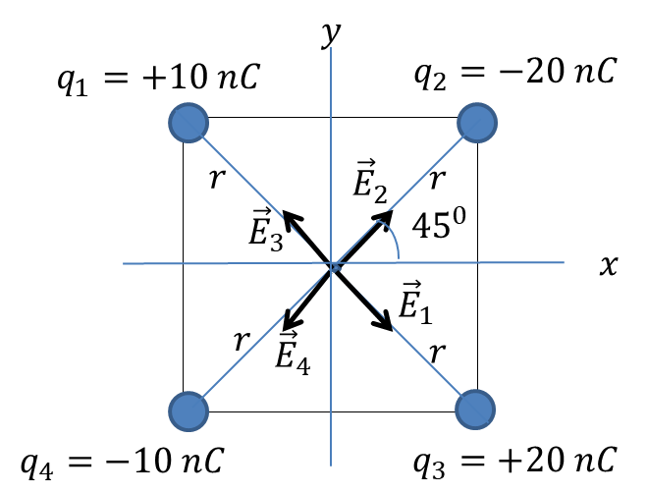
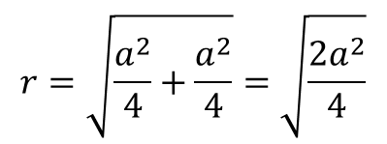
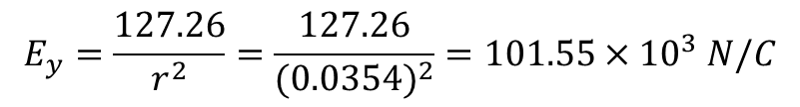

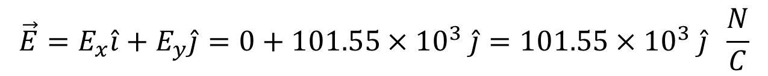
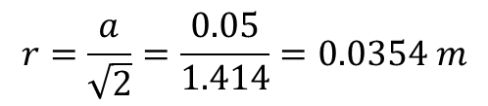
The net electric field at the center of the square along
y-axis is
$$E_{y}=E_{2}cos{45}^{0}+E_{3}cos{45}^{0}−{(E}_{1}cos{45}^{0}+E_{4}cos{45}^{0})$$
$$E_{y}=E_{2}cos{45}^{0}+E_{2}cos{45}^{0}−{(E}_{1}cos{45}^{0}+E_{1}cos{45}^{0})$$
$$E_{y}={2E}_{2}cos{45}^{0}−{2E}_{1}cos{45}^{0}$$
$$E_{y}=\frac{2×9×{10}^{9}×20×{10}^{−9}×0.707}{r^{2}}−\frac{2×9×{10}^{9}×10×{10}^{−9}×0.707}{r^{2}}$$
$$r=\sqrt{\frac{a^{2}}{4}+\frac{a^{2}}{4}}=\sqrt{\frac{2a^{2}}{4}}$$
$$E_{y}=\frac{127.26}{r^{2}}=\frac{127.26}{{(0.0354)}^{2}}=101.55×{10}^{3} N/C$$
$$r=\frac{a}{\sqrt{2}}=\frac{0.05}{1.414}=0.0354 m$$
$$\vec{E}=E_{x}\hat{i}+E_{y}\hat{j}=0+101.55×{10}^{3} \hat{j}=101.55×{10}^{3} \hat{j} \frac{N}{C}$$

Slide 11
THANK YOU

